Slide 1
Electronic Instrumentation Section-1, Ppt-3
Conversion of a galvanometer to voltmeter and ammeter

Slide 2
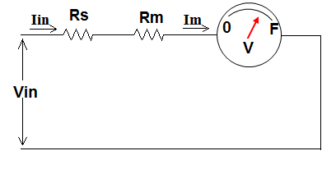
Conversion of galvanometer a DC voltmeter
Full scale defection (FSD) current of a galvanometer is normally 1 mA. It is the current at which the galvanometer pointer moves from its minimum (zero) position to maximum (100 %) position on the dial / scale. If a galvanometer is to be converted in to voltmeter, a resistance is connected in series with the galvanometer coil. The series resistor value is selected such that, at the maximum input voltage value to be measured the galvanometer coil current will be 1 mA.
e.g. For 0 to 100 V range; Vin(max) = 100 V.
Iin = Im = Ifsd = 1 mA = full scale defection current
Assume meter coil resistance Rm = 200 Ω,
then by ohms law,
IFSD = Vin(max) = 1 mA = 100 V
Rs + Rm Rs + 200 Ω
Therefore, Rs = 99.8 k Ω
Rs = external series resistor
Rm = Galvanometer coil resistance
Im = galvanometer coil current
Vin = input voltage to be measured
Iin = input current
Fig. 1.

Slide 3
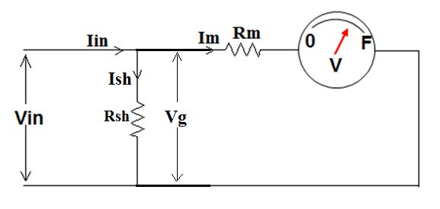
Conversion of galvanometer a DC ammeter
As shown in Fig. 2. By KCL;
Iin = Ish + Im Hence, Ish = Iin - Im
Also by Ohms law, the voltage across the galvanometer
will be given by Vg = IshRsh = ImRm
Therefore, Rsh = ImRm
Ish
Substituting Ish = Ish = Iin – Im in the above equation,
Then the equation become; Rsh = ImRm
Iin - Im
Example: For converting a galvanometer to an ammeter for current range of 0 to 1 A. If the coil resistance Rm of the galvanometer is 300 Ω. The required shunt resistor value can be calculated as using the above equation.
For 0 to 1 A range, Im value will be taken as the full-scale deflection current value = 1 mA = 0.001 A. The maximum input current Iin to be measured is 1 A. Then by substituting the values, Rsh required will be:
Rsh = ImRm = 0.001x300 = 0.3 Ω
Iin – Im 1 – 0.001

Slide 4
Problems
A galvanometer with a full scale deflection current of 1 mA is to used for measuring DC voltage of from 0 to 2.5 V range. The coil resistance is 100 Ω. Find the value of the external series resistance required.
A galvanometer with full scale deflection current of 1 mA is to used for measuring DC voltage of from 0 to 10 A range. The coil resistance is 200 Ω. Find the value of the external shunt resistance required.
If the galvanometer with coil resistance of 300 Ω is used. Without connecting any external series or shunt resistor can it be used to measure voltage or current ? If yes, then what will be the ranges.

Slide 5
(Answer: 2.4 k Ω)
(Answer: 0.02 Ω)
3. (Answer: Yes. Voltage range = 0 to 300 mV and current range = 0 to 1 mA (i.e. only up to the full
scale deflection current)

Slide 6
Q.1) The best advantage of analog instruments as compared to the digital instrument is that
A) They are rugged on construction
B) They have very high accuracy
C) They are smaller in size
D) They do not require auxiliary power supply for their operation

Slide 7
Q.2) For conversion of a galvanometer to a voltmeter
A) A resistor is connected in series with the galvanometer coil
B) A resistor is connected in parallel with the galvanometer coil
C) An inductor coil is connected in series with the galvanometer coil
D) An inductor coil is connected in parallel with the galvanometer coil

Slide 8
Q.3) For conversion of a galvanometer to an ammeter
A) A resistor is connected in series with the galvanometer coil
B) A resistor is connected in parallel with the galvanometer coil
C) An inductor coil is connected in series with the galvanometer coil
D) An inductor coil is connected in parallel with the galvanometer coil

Slide 9
Q.4) A galvanometer with coil resistance of 300 and full-scale deflection current of 1 mA is to be converted to a voltmeter for measuring the DC voltages up to 50 V. The value of external resistor required to be connected in series with the coil is
a) 50 kΩ
b) 47.7 kΩ
c) 60 kΩ
d) 300 kΩ

Slide 10
Q.4) A galvanometer with coil resistance of 300 and full-scale deflection current of 1 mA is to be converted to an ammeter for measuring the DC current up to 5 A. The value of external resistor required to be connected in series with the coil is
A) 0.06 Ω
B) 0.03 Ω
C) 0.05 Ω
D) 0.001 Ω

Slide 11
Thank you

